Slide 1


Created by: Ivan Markov & Vladimir Vuchkov

Slide 2
This Is A Point To Shoot Type Of Game
Using Java Programming Language
Created With LibGDX Framework
Written With Android Studio 1.2.2
Additional Programs Used :
Texture packer, Photoshop, Gold Wave
Using Git For Source Control
Regex For Validation

Slide 3
Working Communication With A Server
Offline Mode Included !
Async Data Loading For Better User Experience
Singleton

Slide 4
Animated Enemies
Different Types Of Enemies
Special Sound FX
Interactive Buttons

Slide 5
3 Types Of Weapons
Each Unlocked At Different Stage Of The Game
Each With Specific Damage And Sounds

Slide 6
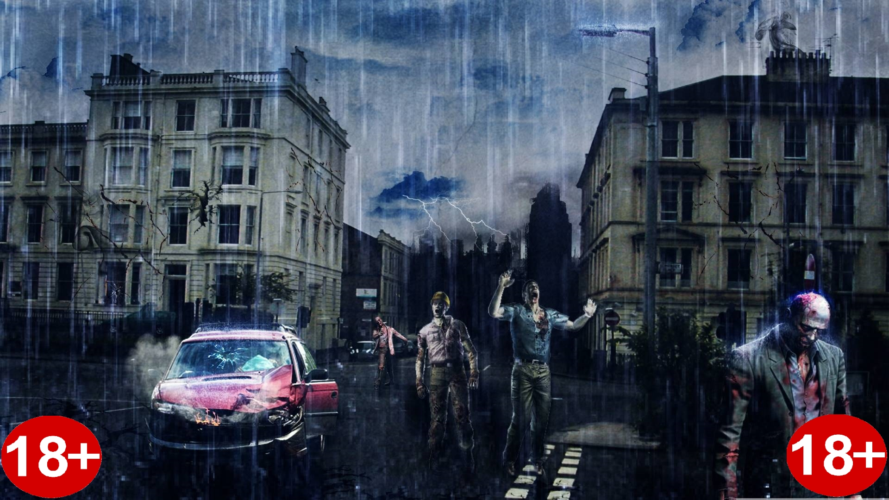
3 Types Of Difficulties, Each With 6 Paragon Levels ! Total of 18 Unique Difficulties
The Game Is Not Recommended For
Minors Due To The Special Game BOSS !

Slide 7
GAME DEMONSTRATION …

Slide 8
Special Secret Bonus Level
Pause Button
First Person Weapon Visualization
Plans For The Future !

Slide 9
Thanks To Our Backend Team: Cvetelina Petkova & Mirela Karadachka
Special Thanks To Our
Teacher And Mentor Nikolay !

